Slide 1
Weka Machine Learning
Abraham Lezama & Nicolas Sandoval
Diabetes Data Set

Slide 2
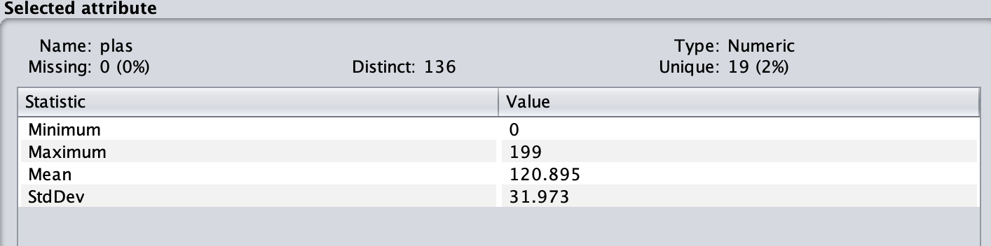
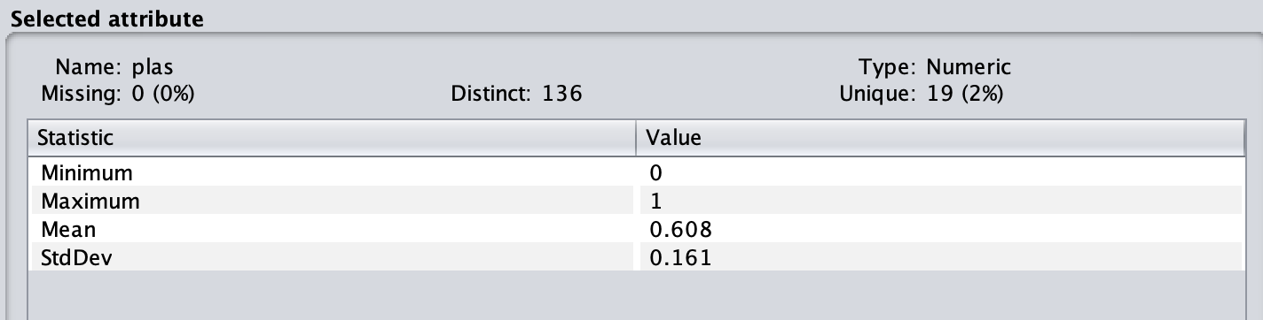
Data Normalization
Each independent variable has its own min and max value
Data scaling is needed to perform a regression or classification model on the data
It will lead to problems when building a model if the data is not in the same scale range
According to my data science class, one needs to scale (normalize) the features before training/testing

Slide 3
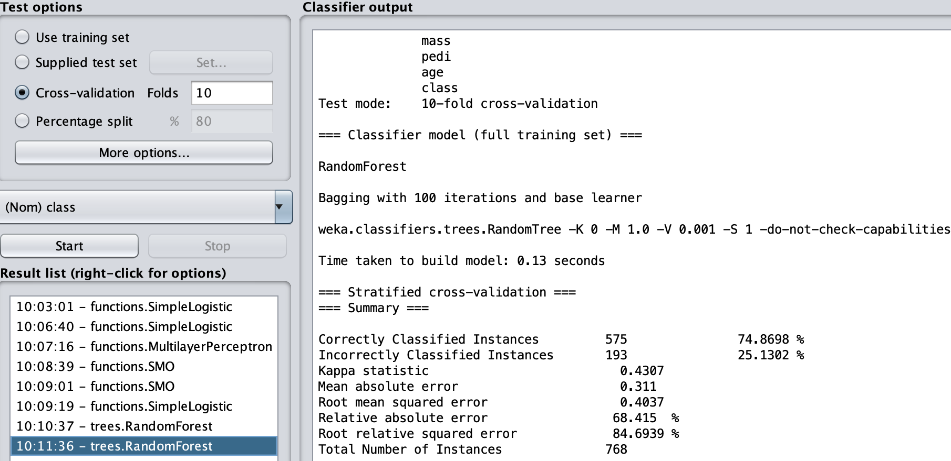
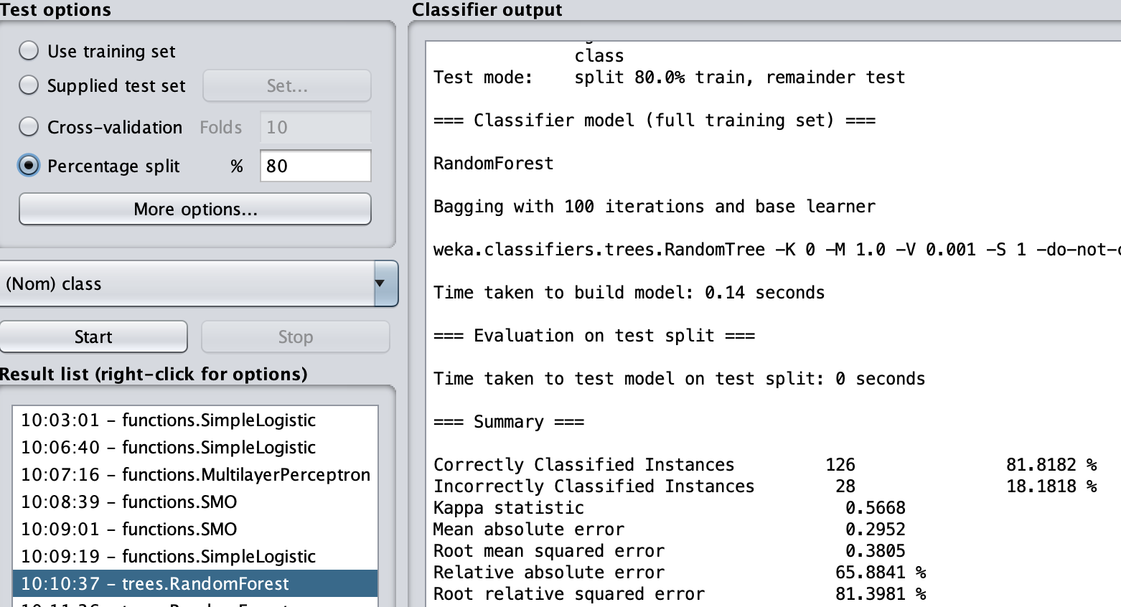
Random Forest
Random Forest algorithm performed with different test options
Percentage split performed better than cross-validation folds
For percentage split, the training data was 80% and the testing data 20%
For cross-validation, data is split in 10 segments, where 9 segments are for training and 1 is for testing. The process is done 10 times until every segment is used as the testing data

Slide 4
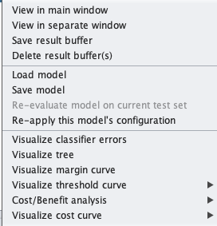
Visualization
Weka offers different types of visualizations to help us make better sense of the data.
Some of the options include cost/benefit analysis, margin curve, threshold curve, etc.

Slide 5
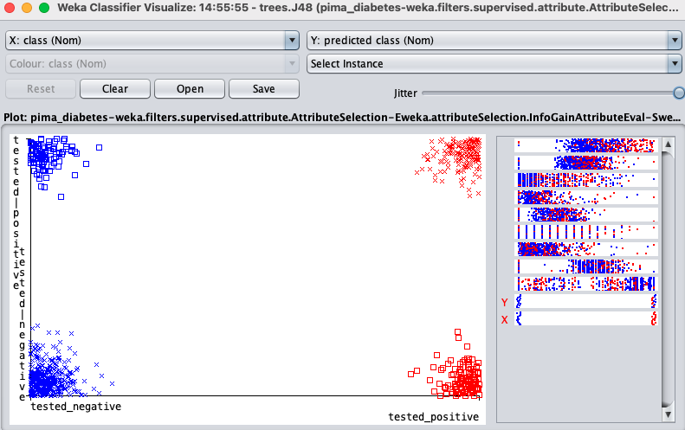
Classifier Errors
Visualization of J48 correct and incorrect predictions
It displays true positives and false negatives
It also display false positives and false negatives
True Positive
False Negatives
True Negatives
False Positive

Slide 6
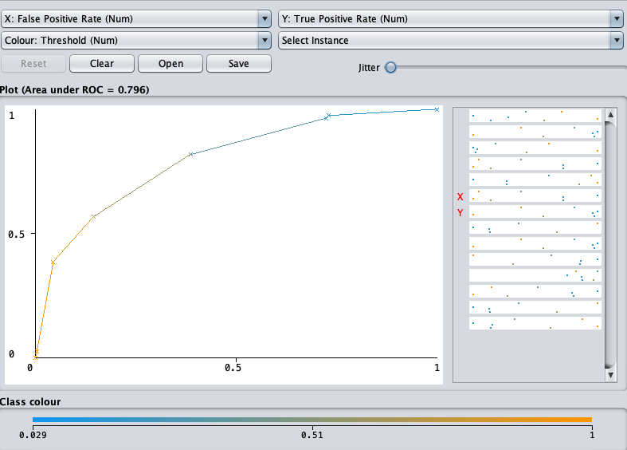
Classifier Threshold Curve
Area under ROC of the J48 classifier is the ability of the classifier to distinguish between classes. The greater the area, the better
Area under ROC curve is a measure of the usefulness of a test in general
The plot shows the true positive and and false positive rate

Slide 7
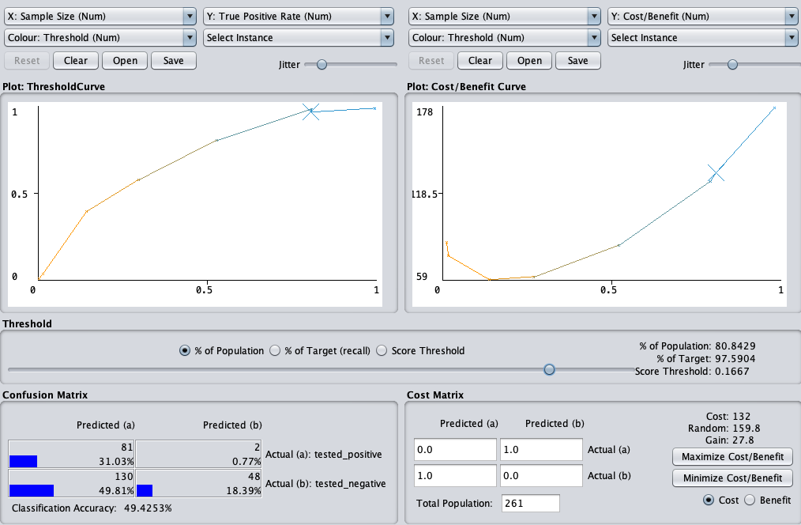
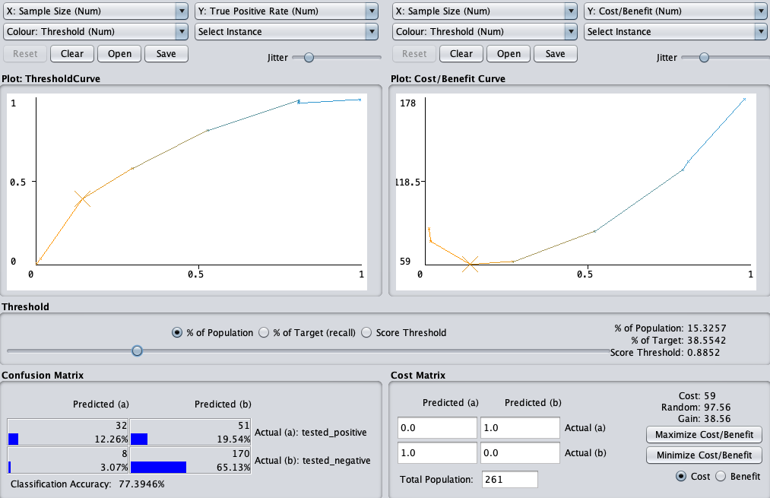
Classifier Cost/Benefit Analysis
J48 tree classifier cost/benefit analysis
Adjust population percentage

Slide 8
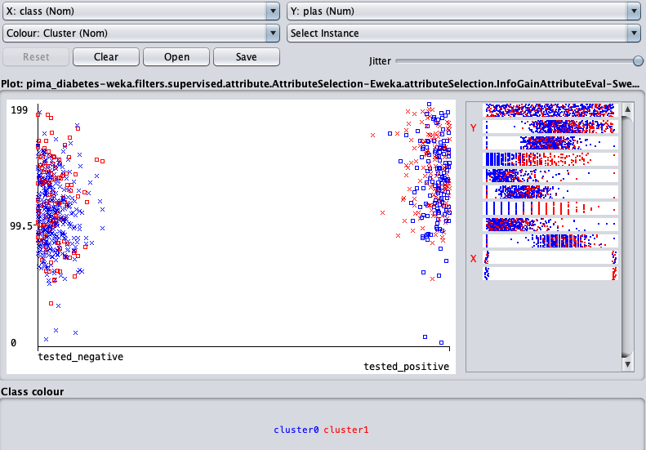
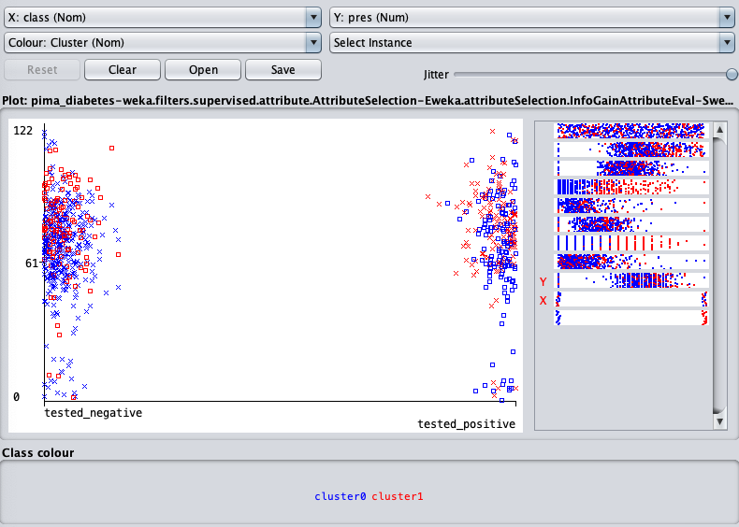
SimpleKMeans Clustering
Clustering accuracy visualization based on plasma and blood pressure

Slide 9
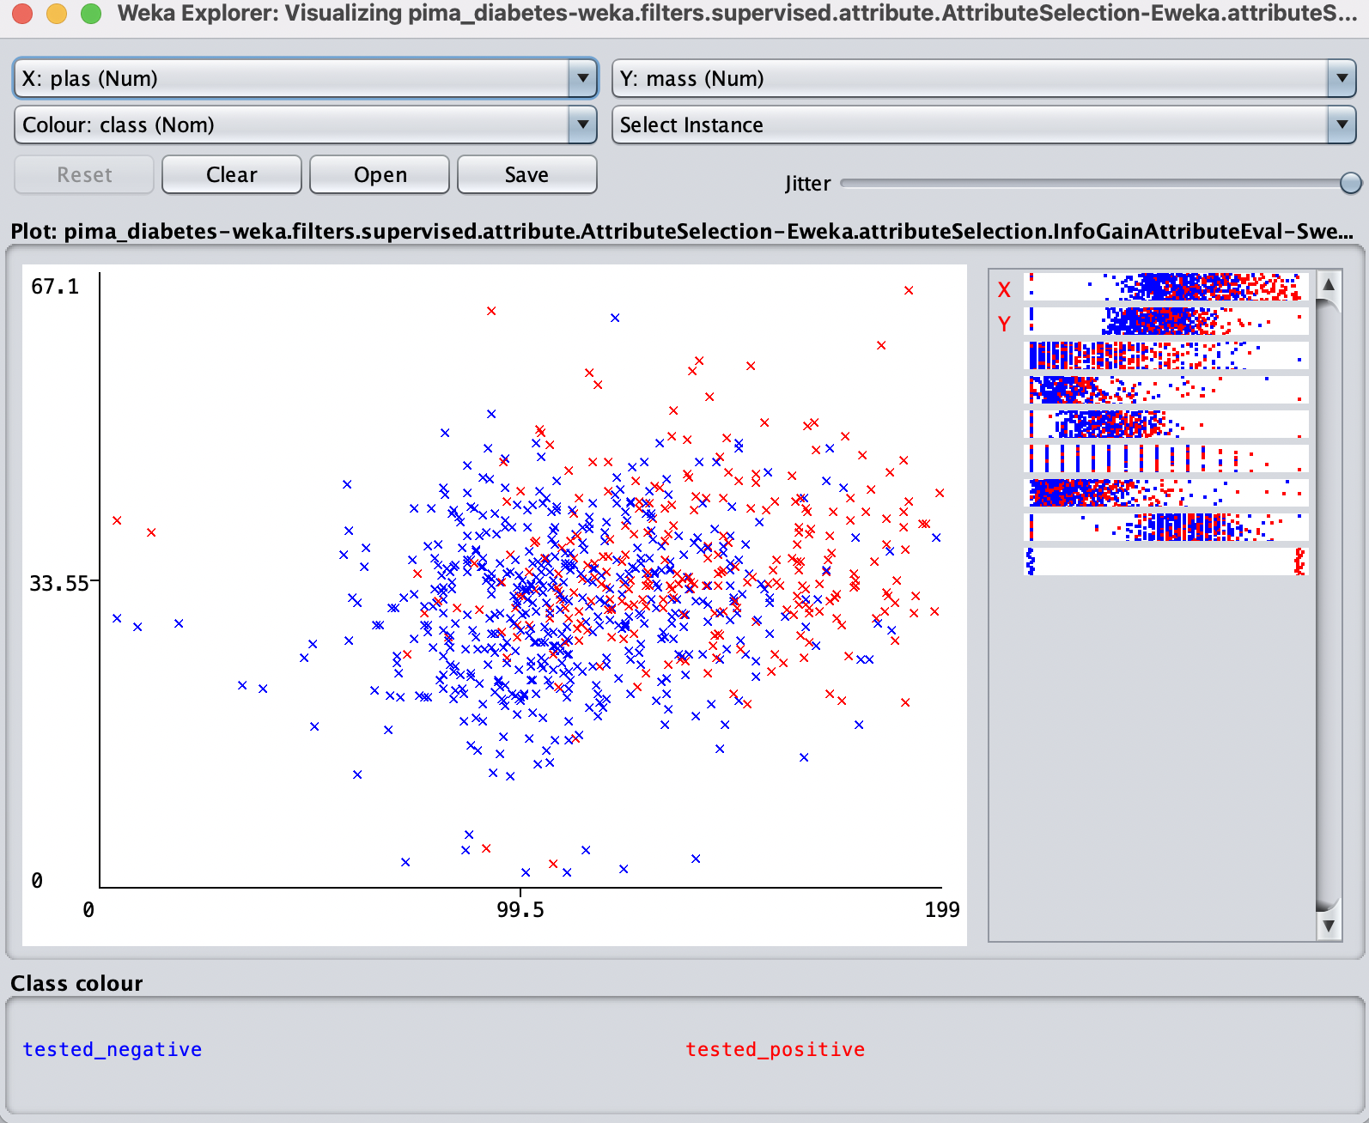
Plot Matrix
We can visually see the connection of diabetes in patients between two attributes by plotting them on the x and y graph.
In this graph, we can see that the higher your plasma glucose levels are in connection with a BMI of 33.55, the more likely you are to have diabetes. (a BMI>30 is considered obese)
Red marks mean positive patients
Blue marks mean negative patients

Slide 10
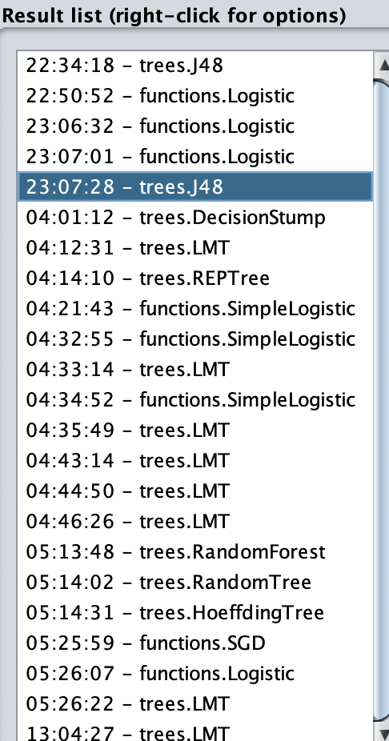
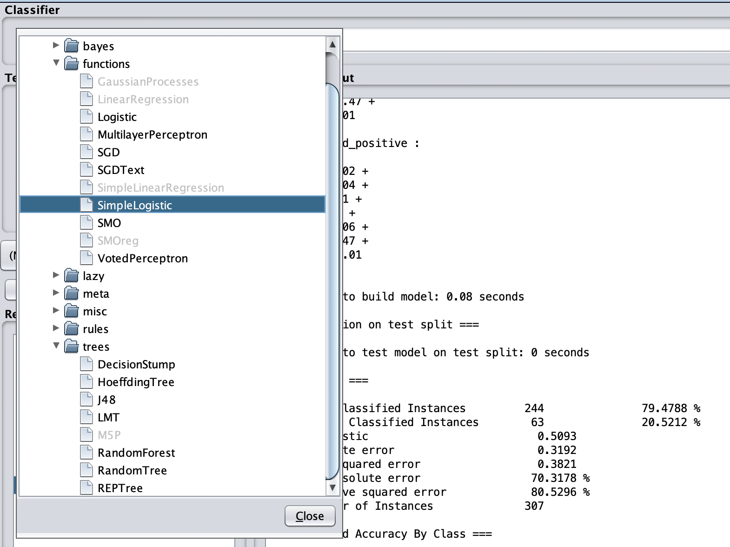
Training Classifiers
Classifiers are helpful ways to build and train data using trees by categorizing data based on input.
Using different classifiers is useful in machine learning algorithms because they lower the risk of ambiguous data

Slide 11
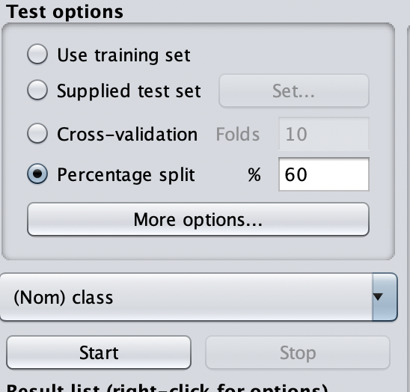
Testing Options
When using WEKA, you have different testing options that are useful for different scenarios.
Pick what best fits your goal of the machine learning algorithm
Training set is useful for being illustrative since you are using the actual data to make a model.
Cross validation is useful when you aren’t sure where to split your data. You randomize the training data and testing data into different “folds” or partitions and get the average to make your model.
Supplied set is useful for large amounts of data where you don’t need to test everything, just a portion
Percentage split is useful when you want to get a fast idea of what your predictive model will be like. It is accurate when splitting the data into 80% training and 20% testing.

Slide 12
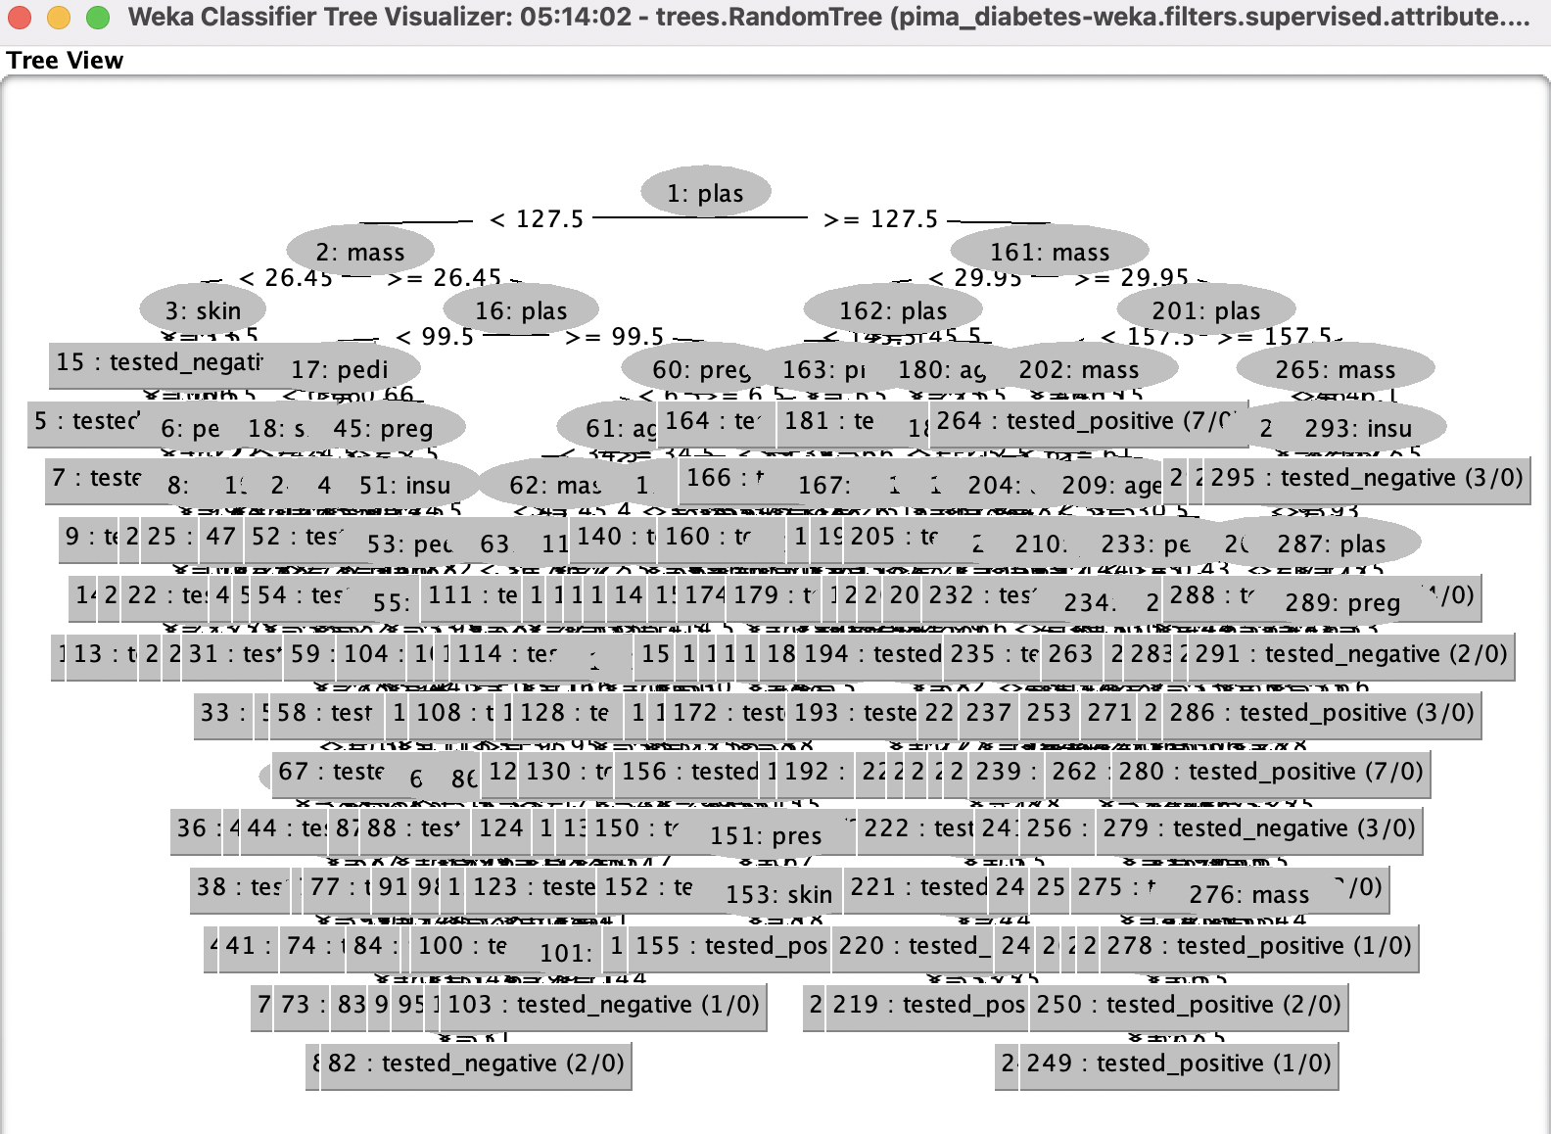
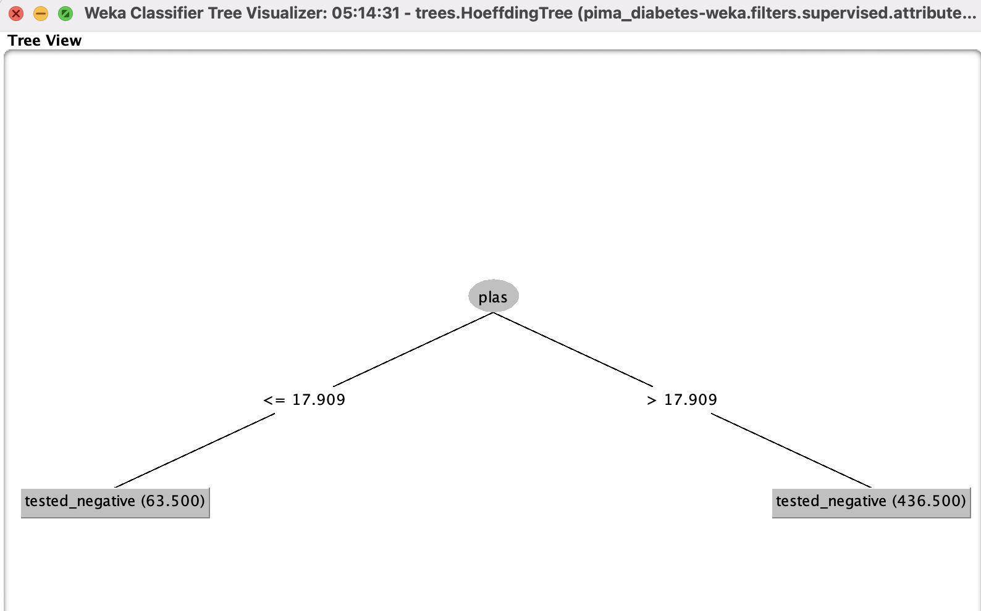
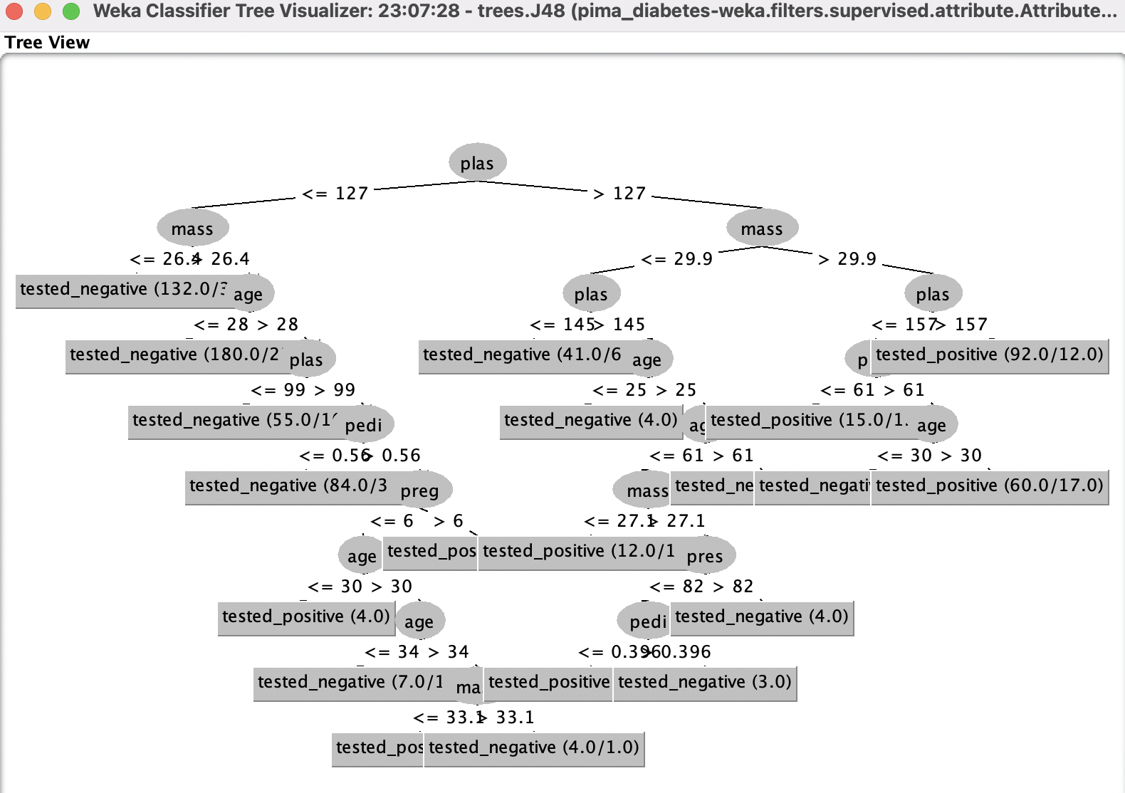
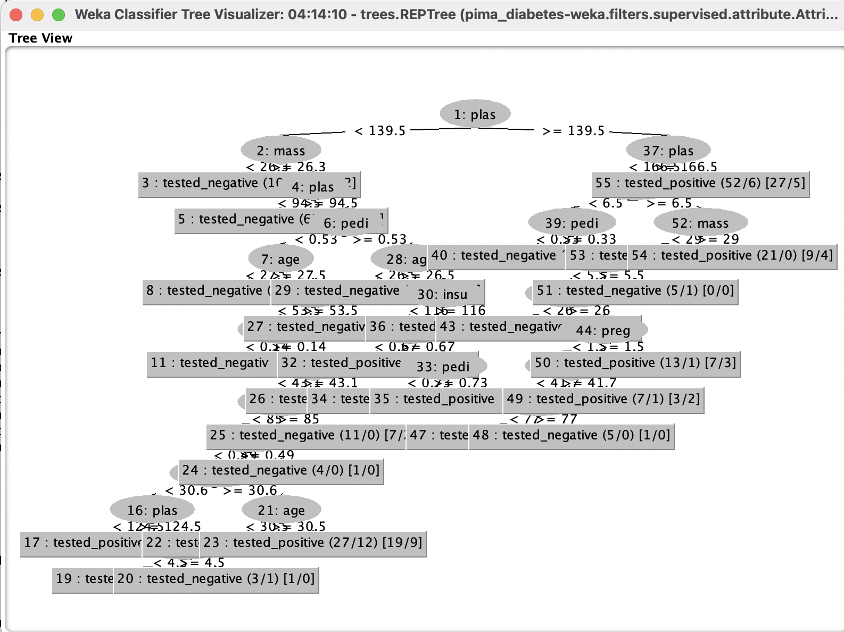
Tree Visualization
Hoeffding Tree
Random Forest Tree
J48 Tree
REP Tree

